Slide 1

Product Data using python
BI CASE STUDY
Analysis on

Slide 2
Project Overview: -
Myntra is big clothing and accessories e-commerce website, which was found in 2007 & in may 2014 it was acquired by flipkart.
In this project we have product dataset of myntra, in which have used analytical skills to identify the customer’s choice of products & which parameters attract them to make purchase the products.
We have used exploratory data analysis (EDA) approach to analyse this data and summarise the main characteristics.
Python libraries used for this analysis:-
1. Numpy
2. Pandas
3. Matplotlib
4. Seaborn
5. Plotly express

Slide 3
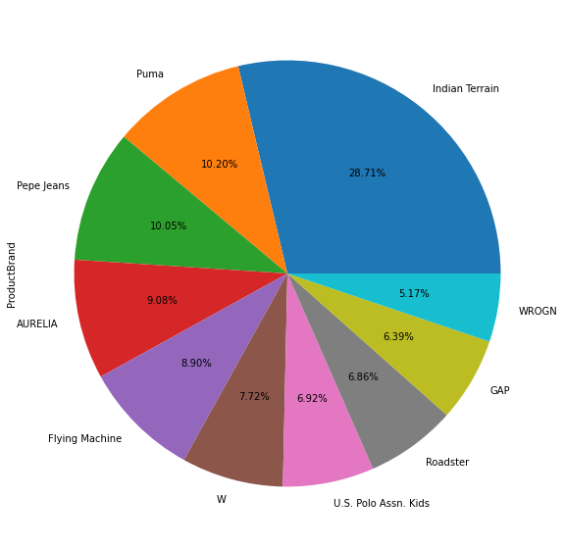
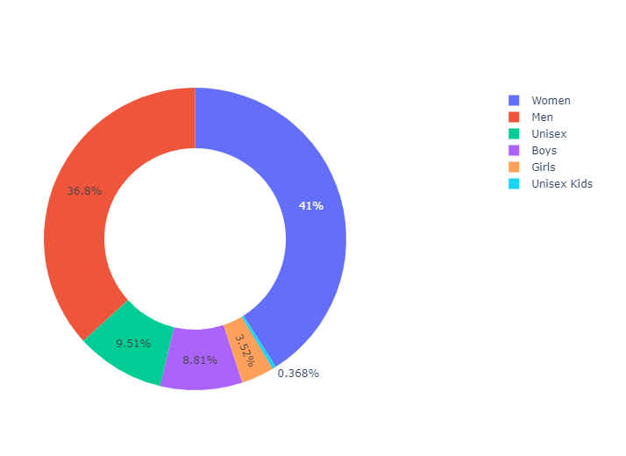
Univariate and Bivariate Analysis
Percentage contribution of top brands in total inventory. Among the brands below are the top 5 contributors: Indian Terrain, Puma, Pepe Jeans, AURELIA, Flying Machine | Gender proportion in overall inventory. The inventory is majorly filled up by the female products and then the male products.

Slide 4
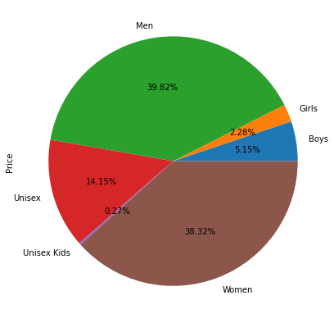
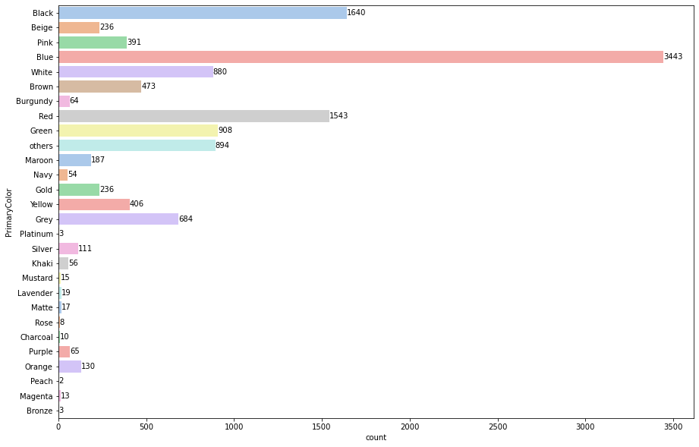
Univariate and Bivariate Analysis
Color wise pricing. The blue colored products are the costliest products than other colors. | Gender wise price distribution. Among total cost of inventory men's products have the major distribution.

Slide 5
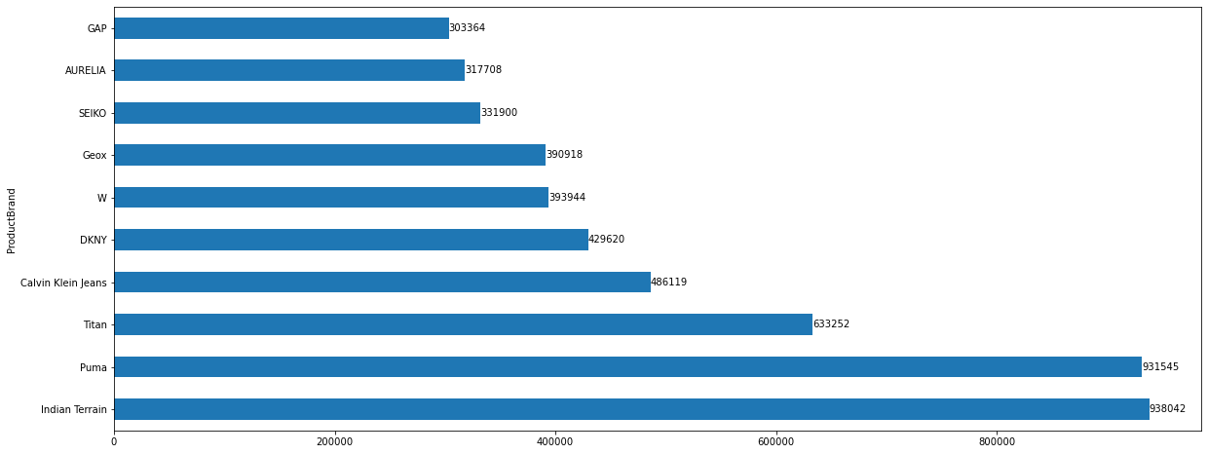
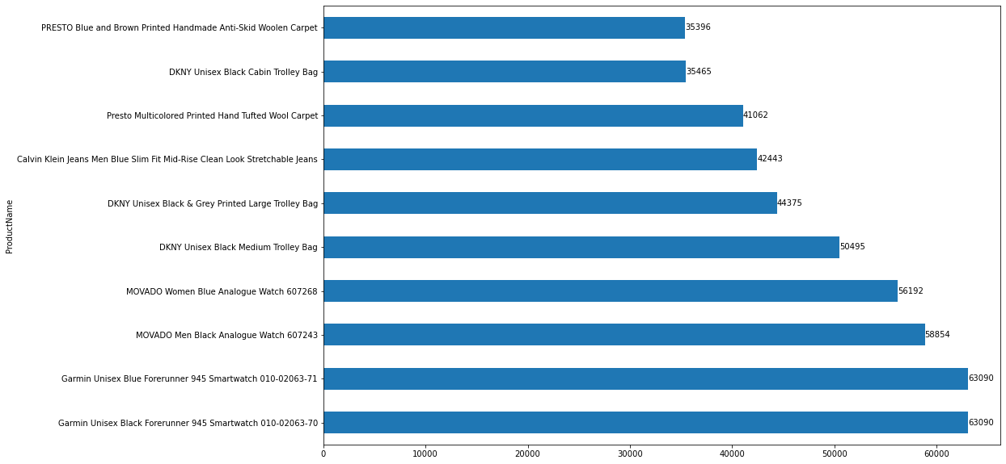
Univariate and Bivariate Analysis
Top 10 brands by means of price. Among these 10 brands top 3 brands are: 1. Indian Terrain 2. Puma 3. Titan | Top 10 products by means of price. Among these 10 brands top 3 brands are: Garmin Unisex Black Forerunner 945 Smartwatch 010-02063-70 Garmin Unisex Blue Forerunner 945 Smartwatch 010-02063-71 MOVADO Men Black Analogue Watch 607243

Slide 6
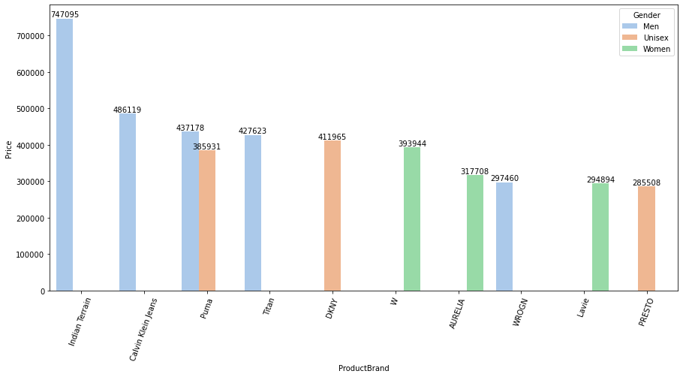
Multivariate Analysis Gender wise top 10 brands pricing

Slide 7
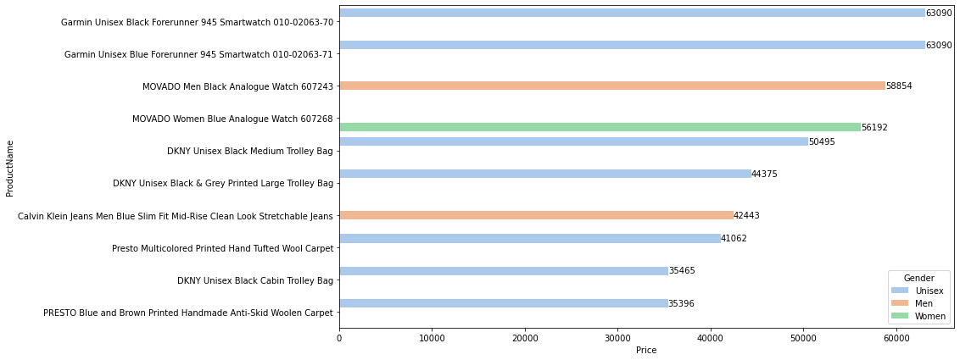
Multivariate Analysis Gender wise top 10 products pricing

Slide 8
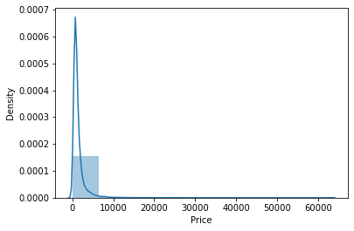
Distribution of Product Pricing.

Slide 9
THANK YOU

